Slide 1
PHD Progression
Explainable AI with Visual analytics

Slide 2
NLP
Why RNN?
Data points independent
Input layer size is fixed
Types of RNN
One to one, one to many, many to one, many to many

Slide 3
NLP
Problems that Occur in RNN?
Vanishing and exploding gradient
Solution for vanishing and exploding gradient
Use Relu activation function, Rmsprop optimizer
Use LSTM’s

Slide 4
Pretrained models
VGG16
Mobilenet
Transfer learning

Slide 5
NLP
Field of study that enables computer to understand interpret and generate human languages
NLP Basics
NER
Machine Translation
Sentiment analysis
Question answering systems

Slide 6
LLM4vis: Explainable Visualization Recommendation
LLM4Vis consists of several key steps
feature description
demonstration example selection
explanation generation bootstrapping
prompt construction
inference

Slide 7
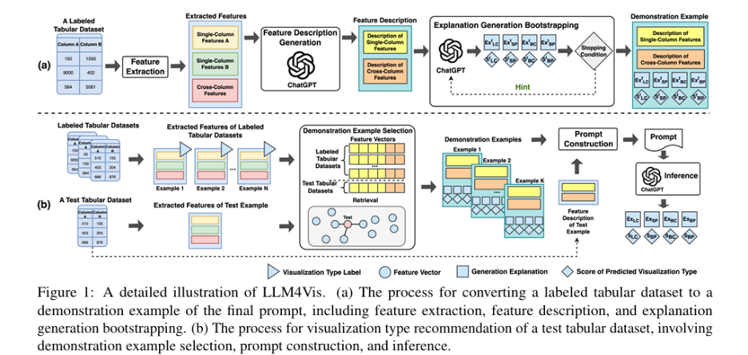
LLM4vis: Explainable Visualization Recommendation

Slide 8
Feature description
we can first use predefined rules to transform it into sets of data features that quantitatively represent its characteristics
We categorize the data features related to columns into
Types
Values,
Names

Slide 9
Demonstration Example Selection
A ChatGPT prompt could only accommodate a small number of demonstration examples
We use a clustering algorithm to select a representative subset of examples from the labeled set
subset of size M =C×R as the retrieval set.
clustering algorithm creates C clusters
we choose R representative examples from each cluster

Slide 10
Explanation Generation Bootstrapping
Each labeled data example Xi comes with only one ground truth label Yi
leverage the built-in knowledge of ChatGPT to recommend the appropriate visualization
instructing ChatGPT to generate a response in a JSON format
{YLC,YSP,YBC,YBP} (LC: line chart, SP: scatterplot, BC: bar chart, BP: Box plot)
values are recommendation scores {SLC,SSP,SBC,SBP}
We prompt ChatGPT to generate explanations {ExLC,ExSP,ExBC,ExBP}

Slide 11
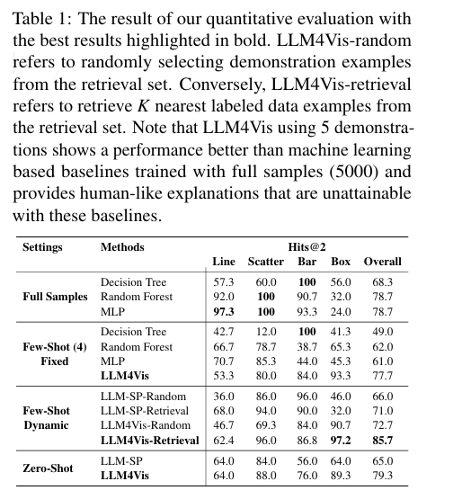
Prompt Construction and Inference

Slide 12
Prompt Construction and Inference
We compare with strong visualization type recommendation baselines from VizML
We also compare our method to a simple prompting technique named LLM-SP

Slide 13
Results
Table 1 shows that our few-shot LLM4Vis outperforms all baselines
indicates that LLMs can effectively recommend appropriate visualization types by learning from limited demonstration examples
Note that even zero-shot LLM4Vis can outperform these strong baselines.

Slide 14
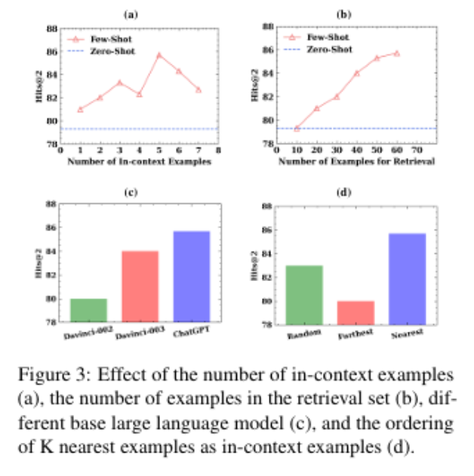
Effect of each component
Figure 2 presents the comparison results of variants of LLM4Vis, wherein one component is either removed or replaced.

Slide 15
Building the prototype

